Slide 1
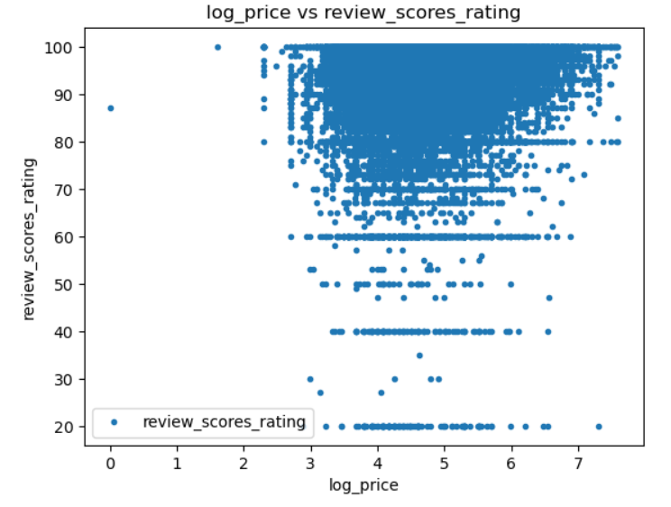
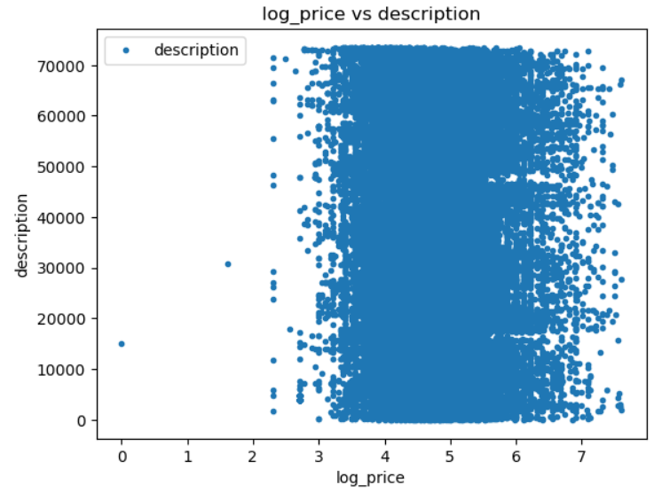
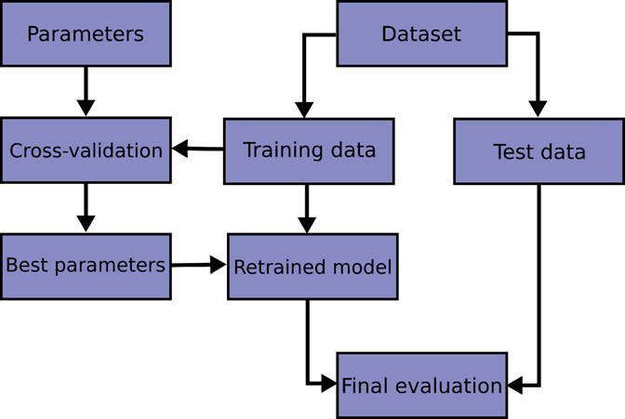
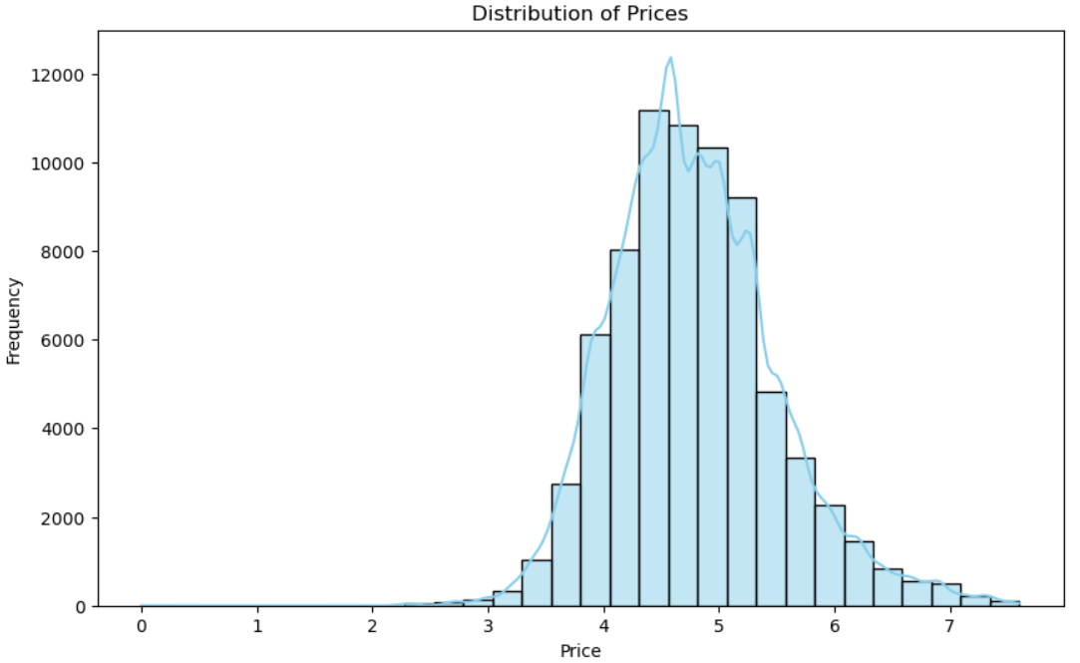
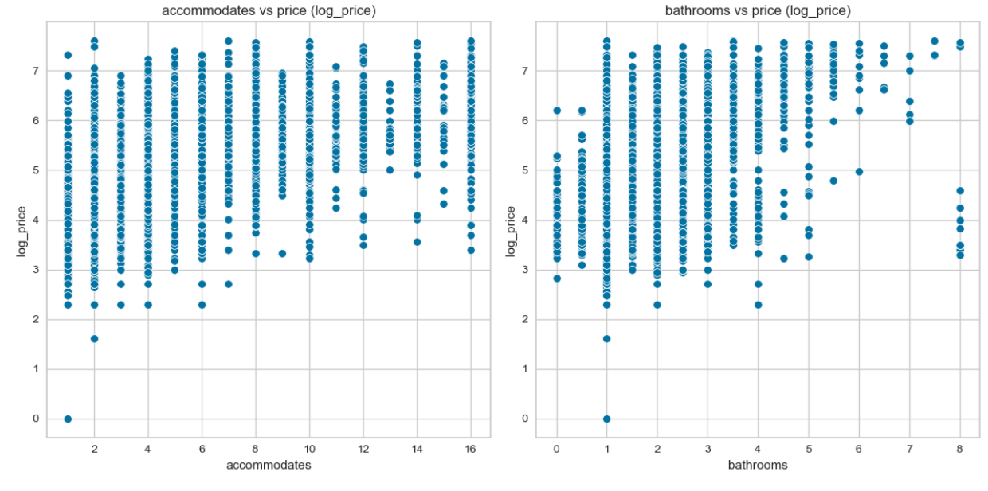
" The multifaceted influence of various attributes such as location, property type, and amenities, on the dynamic pricing trends within the Airbnb platform "
Lorrany I. C. dos Santos
INTRODUCTION
Digital technologies have revolutionized organizational operations, prompting the need for innovative solutions and diverse applications. Despite the broad scope of technology, this research project focuses specifically on Data Analysis as the proposed solution to the identified challenge. According to the UCD website, Data Analytics involves analyzing raw data to conclude business decisions. Data Analytics is essential for predicting trends, understanding customer behaviour, and optimizing budget allocation. Harold suggests that effective project management commences with delineating the project itself. A project, in essence, embodies a sequence of tasks and activities with a distinct goal to be achieved within predefined parameters, such as specified objectives, clear start and end dates, and, if pertinent, financial constraints. The essence of project management lies in optimizing resource utilization by fostering both horizontal and vertical flow of work within the organization. This methodology doesn't seek to dismantle the hierarchical structure but rather encourages interdepartmental collaboration to ensure seamless progress across the organization (KERZNER,2017).
Data analytics initiatives must harmonize with the overarching business aims and strategic objectives of the company. Clients expect project management to certify that projects are synchronized with these objectives and play a role in their attainment (HOTZ,2024).
Non-parametric supervised learning technique for regression and classification that is called a decision tree (DT). The objective is to learn basic decision rules derived from the data features in order to build a model that forecasts the value of a target variable. A tree can be thought of as an approximation of a piecewise constant. Using a series of if-then-else decision rules, decision trees like the Example 1 below learn from data to approximate a sine curve.
Random Forest is a meta estimator that employs averaging to increase predictive accuracy and manage over-fitting when fitting several decision tree classifiers on different dataset subsamples.
In addition to allowing users to post their flats or available rooms, Airbnb also offers insurance to the properties that are listed. In addition to offering travelers the choice of customization for a homestay rather than a hotel, the organization offers extremely affordable solutions. The organization includes a review and rating system where guests and hosts can assess one another in an effort to gain clients' trust and the business offers a review and rating system where hosts and guests can rate one another in order to gain the trust of clients (BASHIR AND VERMA ).
Therefore, with the increasing demand for utilizing data and taking advantage of its opportunities, organizations are seeking clear and simple solutions and guidelines for data management. Accordingly, the project problem of this paper is "The multifaceted influence of various attributes such as location, property type, and amenities, on the dynamic pricing trends within the Airbnb platform".
This scatter plot helps us understand whether there is a trend between the price of an Airbnb listing and its average review score. Interestingly, the scatter plot suggests that review scores do not change significantly as the price rises or falls. This indicates that while price may vary widely among listings, it does not have a strong correlation with review scores. Such a finding could imply that higher prices don’t necessarily guarantee better quality or customer satisfaction, which can be an important insight for hosts on Airbnb.
CONCLUSION
Results and Interpretation:
Linear Regression: Although the error is extremely low, it is likely that the model was overfitted or tested on the same training data, resulting in misleading accuracy. This model may not generalize well to new data;
Decision Tree: The decision tree model does not adequately capture the complexity of the data, reflected by the relatively high RMSE and low R². Individual decision trees tend to be limited in their ability to generalize;
Random Forest: The best model among the three, with a lower RMSE and higher R², indicating that it is able to explain most of the variability in the data and performs better than the other models. These steps provide an initial analysis of the dataset with decision tree and random forest models. This helps to understand the influence of each attribute on the price.
For this dataset, Random Forest is the best choice among the three models tested, as it combines low prediction error and substantial explanation of the data variability. This suggests that it can be trusted to predict prices (or other target variable) with good accuracy, while other models (especially Linear Regression) may not generalize well to new data.
In conclusion, this project investigated the elements that influence dynamic pricing on Airbnb, with a particular emphasis on location, home type, and amenities. The study used machine learning models—Linear Regression, Decision Tree, and Random Forest—and discovered that while Linear Regression demonstrated near-perfect accuracy, this was most likely due to overfitting, revealing limitations in its predictive power for fresh data. The Decision Tree model gave insights but struggled to capture data complexity, as shown by higher RMSE and lower R² values. The Random Forest model was found to be the best effective predictor of Airbnb prices, with low prediction error and high R².
This analysis illustrates the importance of model selection and cross-validation in developing robust predictive models for dynamic pricing. Despite challenges in data management and model tuning, this project has provided valuable insights into pricing trends, setting the groundwork for further refinement and application of these models within the Airbnb platform.
DEVELOPMENT
Understanding the business context helps ensure that the data analytics project is aligned with the organization's overarching objectives. This alignment ensures that the insights derived from the analysis are relevant and actionable for the business. This phase is understanding the goals and constraints and defining the common problems the AI model needs to solve. Doug emphasizes the importance of understanding data before diving into analysis. He explains the significance of data understanding as a foundational step in the data science process, emphasizes that before diving into analysis or modeling, it is crucial to thoroughly understand the data being used. Rose discusses various aspects of data understanding that will be talked about in this project (ROSE, 2020).
Conducting Exploratory Data Analysis (EDA) to gain insights into the structure, distribution, and relationships within the data. Generally used to investigate what data can reveal beyond the formal modeling or hypothesis testing task, and it provides a better knowledge of the data set variables and their interactions. Distribution of Prices allow us to understand the behavior of prices and, with this, adjust the model, understand possible more common price ranges or even make market segmentations based on the distribution of values.
Figure 3
Instead, criteria including service quality, description accuracy, and cleanliness may have a greater influence on ratings than pricing. This investigation may lead to the notion that price is not a significant predictor of guest happiness, which is interesting for hosts who want to maximize their rating without raising rates.
Figure 4
Emily explains that Decision Trees, and particularly Random Forests, are powerful tools for modeling complex datasets, especially when there are intricate interactions between attributes. Random Forests are an ensemble learning method that builds multiple decision trees and combines their results to improve accuracy and reduce overfitting, making them well-suited for handling diverse and complex data. One of the main advantages of Random Forests is their ability to identify non-linear correlations and interactions between features, such as the interplay between location and amenities in predicting property prices. This allows them to capture relationships that simpler models might miss. Additionally, Random Forests offer high predictive accuracy with minimal need for extensive parameter tuning, making them relatively user-friendly and effective for real-world applications (NEWMAN, 2024).
Figure 1
REFERENCES
OBJECTIVE AND PROBLEM DEFINITION
Kerzner, H. (2017). PROJECT MANAGEMENT A Systems Approach to Planning, Scheduling, and Controlling. New Jersey, Tenth Edition, page 29.
Nick Hotz. “The Project Manager in Data Science”. Data Science Process Alliance. https://www.datascience-pm.com/data-science-project-manager/
Verma Rajesh, “AIRBNB DISRUPTIVE BUSINESS MODEL INNOVATION: ASSESSING THE IMPACT ON HOTEL INDUSTRY”. Research Gate. https://www.researchgate.net/profile/Makhmoor-Bashir/publication/306193997_Airbnb_disruptive_business_model_innovation_Assessing_the_impact_on_hotel_industry/links/5b06460ca6fdcc8c2522ac1e/Airbnb-disruptive-business-model-innovation-Assessing-the-impact-on-hotel-industry.pdf
Newman Emily, 2024, “8 Key Advantages of Decision Tree”, Automate Support Orp Yony X, https://corp.yonyx.com/automate-support/advantage-of-decision-tree/
Zhou, Zhi-Hua. (2016). Machine Learning, pages 2-3
The main objective of this project is to develop and implement a plan aimed at using data tools to enhance decision-making processes. This includes improving decision-makers' abilities to make informed choices and achieve better overall outcomes. The plan encompasses various aspects of data analytics, such as understanding data, utilizing appropriate tools, and selecting optimal machine learning models. Additionally, an essential secondary objective of this project is to perform an in-depth analysis of data to uncover significant patterns, trends, and insights about competitors within the industry. This analysis will enable the organization to refine the project’s scope and objectives, ensuring that the final outcome is not only accurate but also highly relevant and aligned with the organization’s competitive landscape. By combining a focus on internal decision-making with an awareness of external trends, this project strives to deliver a balanced approach that fosters both operational efficiency and strategic advantage.
Rather of being a network of hotels, Airbnb describes itself as "a social website that connects people who have space to spare with those who are looking for a place to stay." The business operates as a middleman on a marketplace platform approach that links hosts and guests to facilitate transactions without actually owning any of the rooms (CHOUDARY, 2013).
Figure 2
According to Zhi-Hua, Machine learning is a method that enhances how systems work by learning from past experiences through computer-based techniques. In computer systems, these past experiences are in the form of data. The primary goal of machine learning is to create algorithms that learn from this data to build models. By giving the learning algorithm access to this data, we create a model capable of making predictions based on new observations (ZHOU, 2016).
For this project, we began by selecting Linear Regression as the first model, given its simplicity and interpretability. Linear Regression is one of the foundational algorithms for predictive modeling and is particularly useful in understanding relationships between variables. According to the Scikit-Learn library, Linear Regression constructs a model based on a linear relationship, represented by coefficients w=(w1​,…,wp​) where each wi corresponds to the weight of an individual feature in predicting the target variable. The goal is to minimize the sum of squared differences between the actual target values in the dataset and those predicted by the model. We used Linear Regression to model the relationship between our target variable (e.g., price) and multiple predictors.
Figure 5

